Slide 1

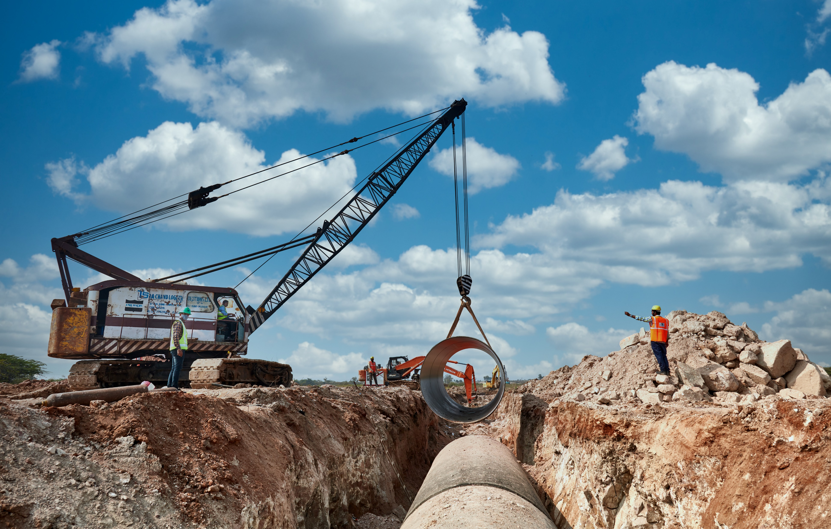


Nandwadgi Lift Irrigation Project

Slide 2

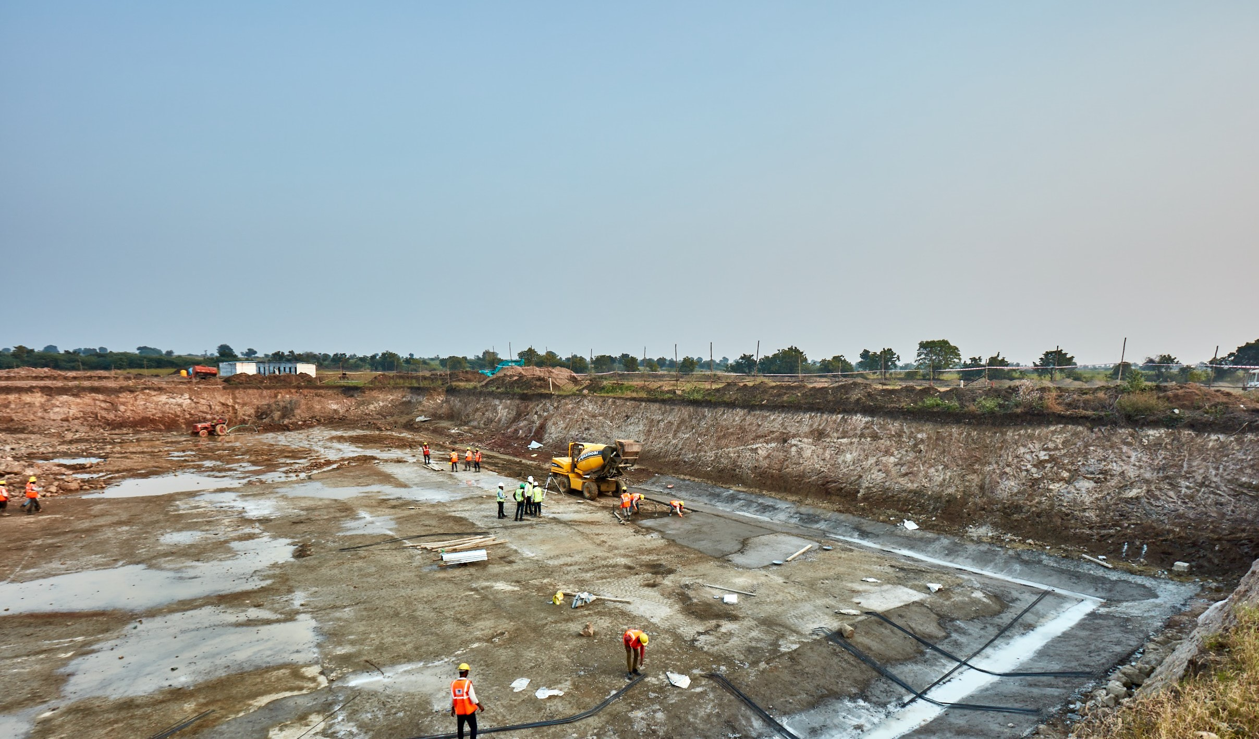

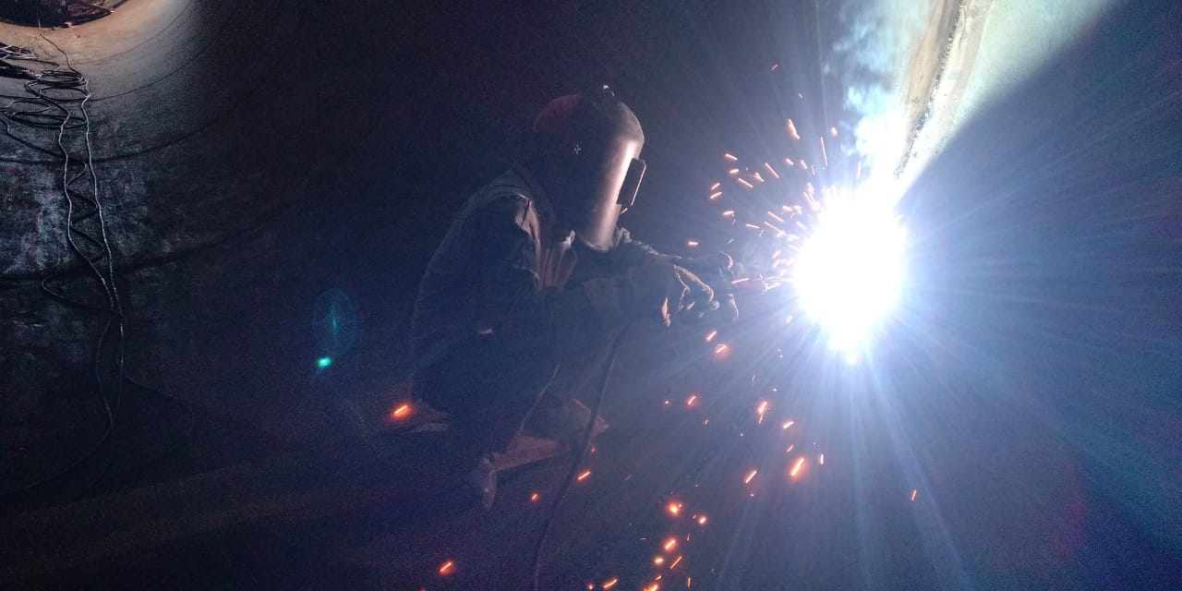
About NLIS
NLIS Objectives
The Nandawadagi lift irrigation project (NLIS) is developing irrigation infrastructure for 12,000 ha of agricultural land.
The project will deliver irrigation infrastructure for 12,150 smallholder farmers across 28 villages. The farmers will receive 28,316 million liters per annum of irrigation water.
The area faces acute shortage as it receives very little rainfall 502 mm and experiences draught frequently. Therefore only 20% of cultivable area is irrigated.
This project will make them climate resilient by providing reliable source of irrigation during cropping season, increasing crop yields and ultimately household incomes.

Slide 3
Beneficiary baseline survey
Implementing stakeholder consultations
NLIS beneficiaries
VCE implement a beneficiary survey to help us validate our understanding of the impact potential and measure overall impact
The survey took 2 months, across 7 villages, interviewing 210 farmers, covering 263.4 ha.
Very few farmers in the region have access to borewell or surface water for irrigation thereby making them excessively dependent on monsoon. The farmers face challenge of unreliable and erratic rain pattern. This affects their crop yields and income making them financially vulnerable.
Household farm size
Avg household income (Rupee)

Slide 4
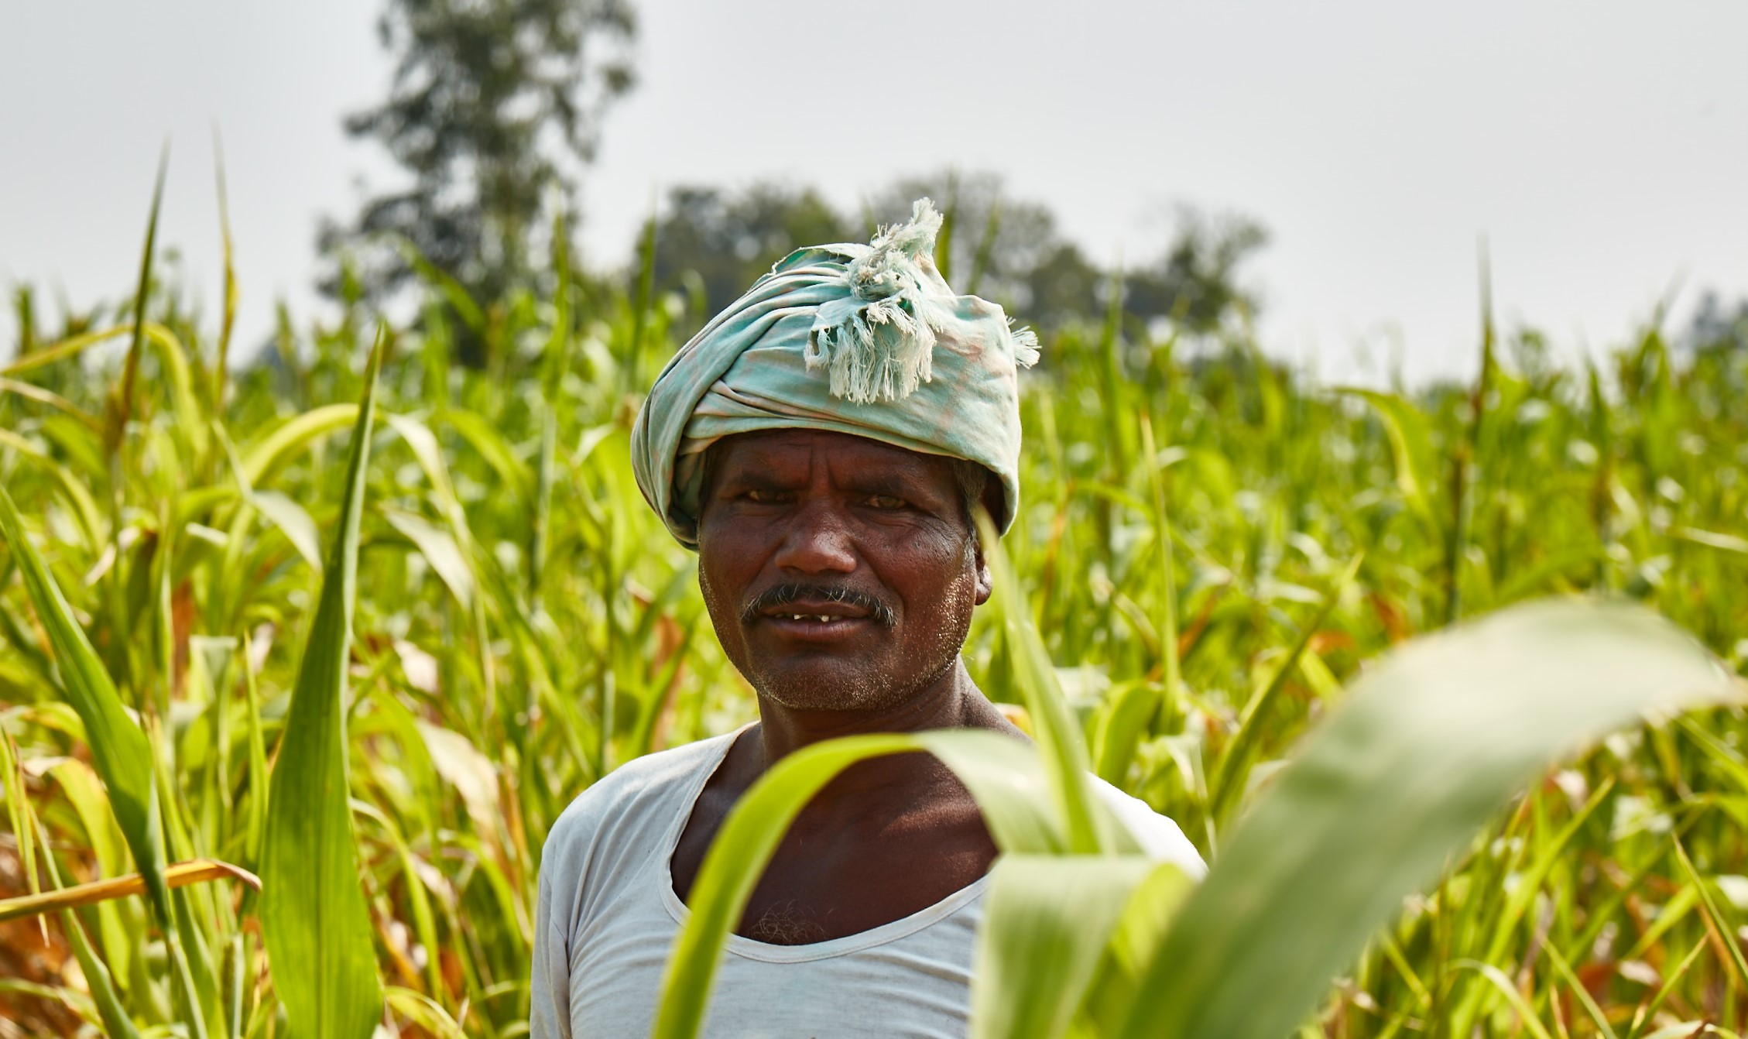
Beneficiary baseline survey
Preliminary results
The average landholding size: 1.26 ha.
Average income: Rs 45,461.
60% of the farmers earning <Rs 50,000.
32% of the famers have to migrate to bigger cities where they work as labourer whereas 66% of the farmers have no other income source.
73% of farmers are dependent on rainfall for cropping.
97% source of water is ground water.
Only 10% feel that they have sufficient water for irrigation. The average depth of groundwater is 170ft and goes as low as 350ft.
Farmers on an avg. use 959 KWh units per year for irrigation.
Kharif(Jun-Oct) which is the main rainfall season remains the main cropping season. As much as 83% only grow crop in the season.
Major crops: Towar(pulses), Sunflower, Bajra, Groundnut.
Cash crops are silk and cotton.

Slide 5
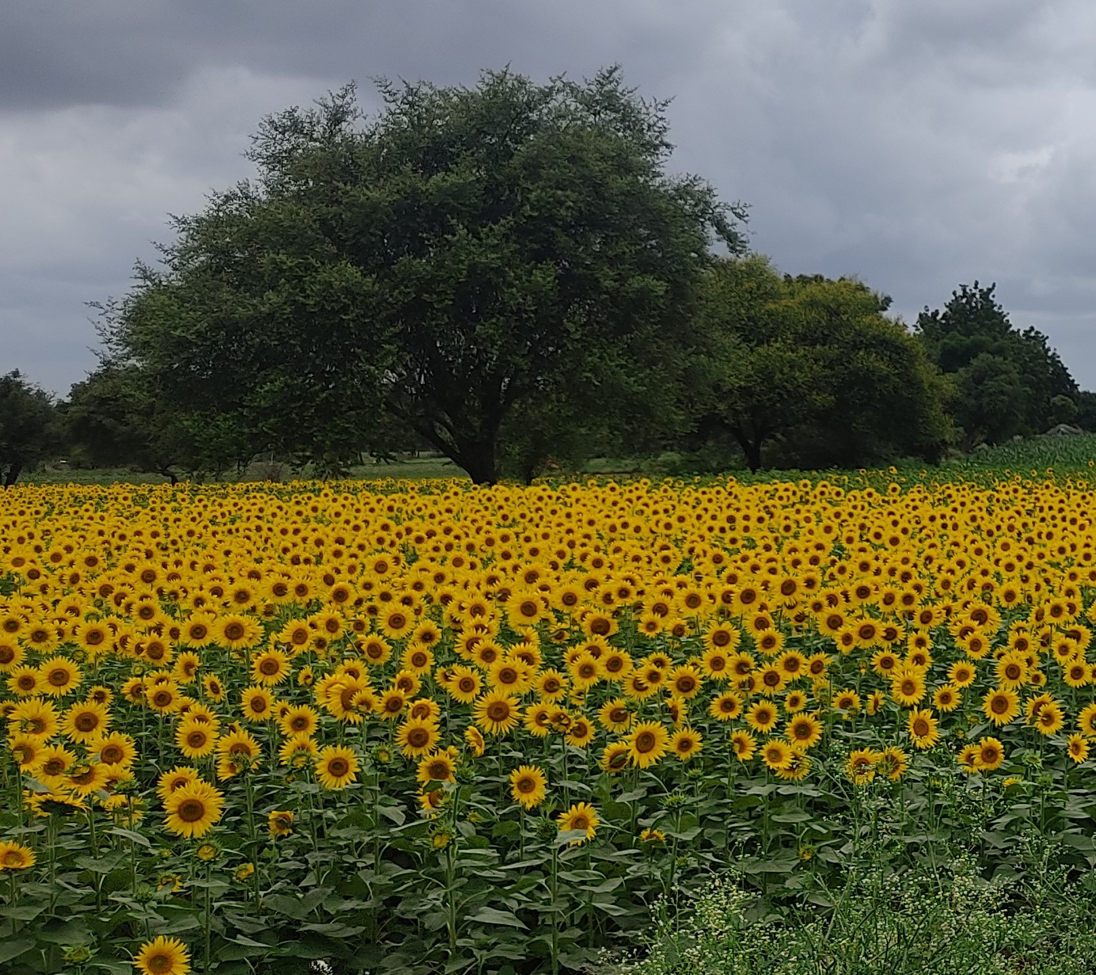
Beneficiary baseline survey
Difference in crop yields of
irrigated and non-irrigated land

Slide 6
Projected impact
60,750
28,316 Million
Individuals benefitting from access to first-time irrigation infrastructure
Liters per annum of irrigation water delivered
12,150
20%
Smallholder farming families engaged
Increase in agricultural yield
12,000 ha
~15%
Increase in smallholder farmers household income
Irrigated land utilizing water efficient drip-irrigation technology

Slide 7
Reason for adoption/ non-adoption of drip
Factors influencing adoption
Medium and large farmers are most likely to adopt to drip irrigation
Field levelling is not required
Maximum use of available water
Low labour cost, the cost of labour for redirecting the water to the crops is not required
Fertilizer usage which includes the less and efficient consumption of fertilizer and disease will not affected for crops
Factors influencing non-adoption
Marginal farmers who holds less than 2.5 acres of land
High initial cost
Do not have permanent water source(dependent on rainfall) to build infrastructure
Have sufficient water therefore doesn’t value efficiency
High maintenance cost
Chances of getting damages by animals
Farmer not getting subsidy from the government
Salt in their water content chocking the holes in the drippers
Perception that plastic will affect soil fertility
Tougher for farmers as farmers lack in technical skill
Source: A Study on Understanding the Adoption of Water Saving Technology: A Case Study of Drip Irrigation (https://www.ijrte.org/wp-content/uploads/papers/v7i6/F2534037619.pdf )- Place Erode district in Tamil Nadu

Slide 8
Benefits of Drip
Drip irrigation has helped bring about crop diversification from rain fed crops to horticultural crops and brought cultivatable waste lands under horticultural crops
Savings in water due to the use of drip varied amongst horticultural crops in the range of 40-65% and in vegetables from 30-40%
Maintenance cost of is very low
Drip irrigation are increase the gross income
Use of drip has also led to a significant reduction of labour in irrigation, weeding, harvesting and eliminated drudgery(manual difficult) in farm management
Fertilizer usage which includes the less and efficient consumption of fertilizer and disease will not affected for crops
Source: Evaluation of Drip Irrigation- A Case Study of Jaipur City (https://www.ijert.org/research/evaluation-of-drip-irrigation-a-case-study-of-jaipur-city-IJERTCONV4IS23020.pdf )
Not sure of the methodology used in the evaluation but the article covers all the regions where drip irrigation has been deployed in India. Not to use Karnataka’s example and Netafim.
https://www.agricultureinindia.net/irrigation-2/micro-irrigation-systems/micro-irrigation-systems-in-india-case-studies-agriculture/18001

Slide 9
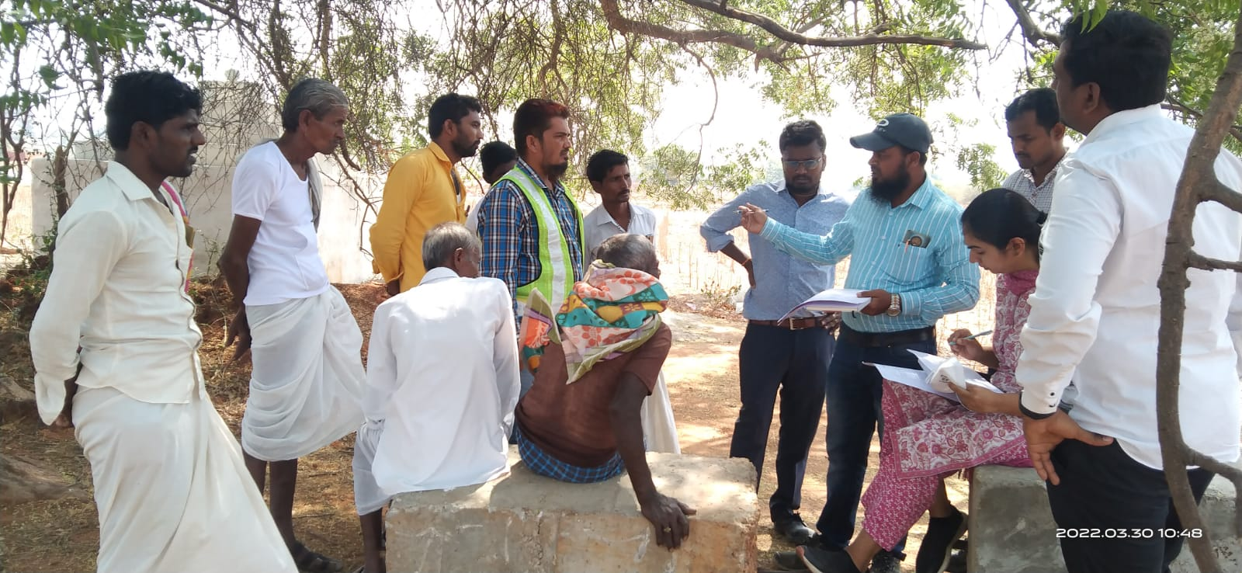
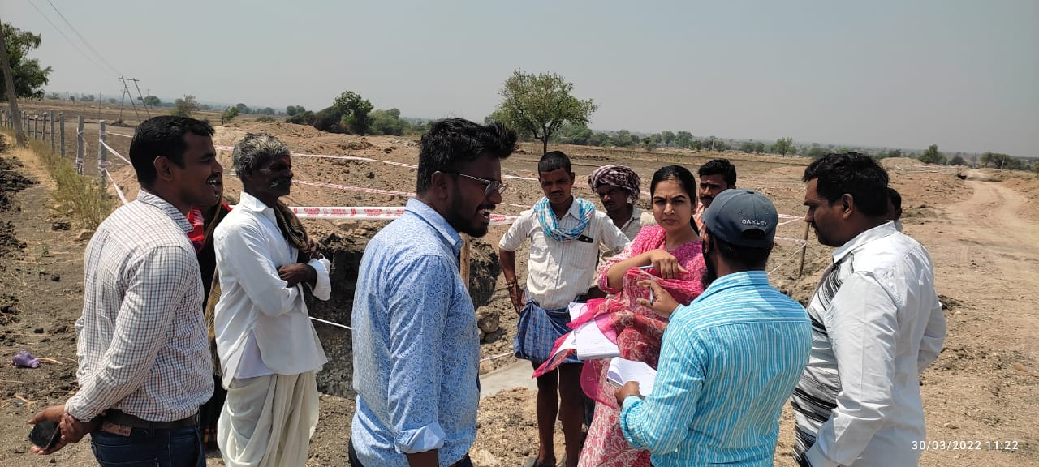
Some photos of consultations

Slide 10
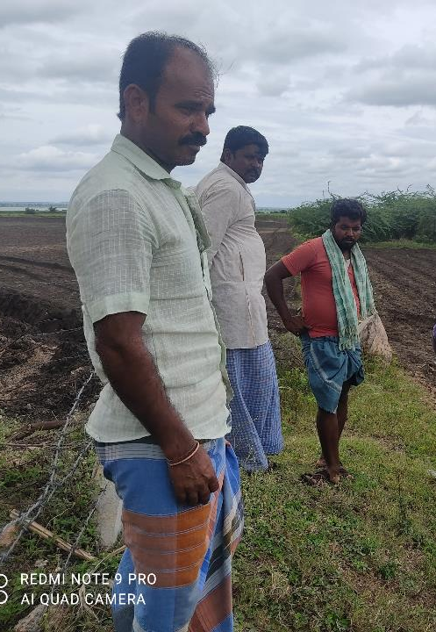
Discussion with farmers
Farmer Name: Amresh, Anand Patil, Manohar Patil
Avg land holding: 4-5 acre
Avg family size: 5
Soil: Black soil
Do not have well or any other irrigation arrangement
Can only grow Bengal gram in Kharif season because of lack of rainfall and irrigation
In good season, 400 Kg/ acre Bengal gram can be produced
Must use tractor @ Rs 2000/ acre for plowing, use DAP fertilizer about 150 Kg
After removing all costs like seeds, fertilizer etc., their earnings are not more than Rs 30,000
The land is close to reservoir, has better moisture in the soil, avg price of land is Rs 10,00,000/ acre
The area has no farmer association, no cooperative societies and lacks accessibility to banking system
They don’t have knowledge of drip irrigation
The area faces drought 30% times, but they have no access to crop insurance system to safeguard their incomes
Therefore, they only grow single crops and migrate to Bangalore to work as construction workers

Slide 11
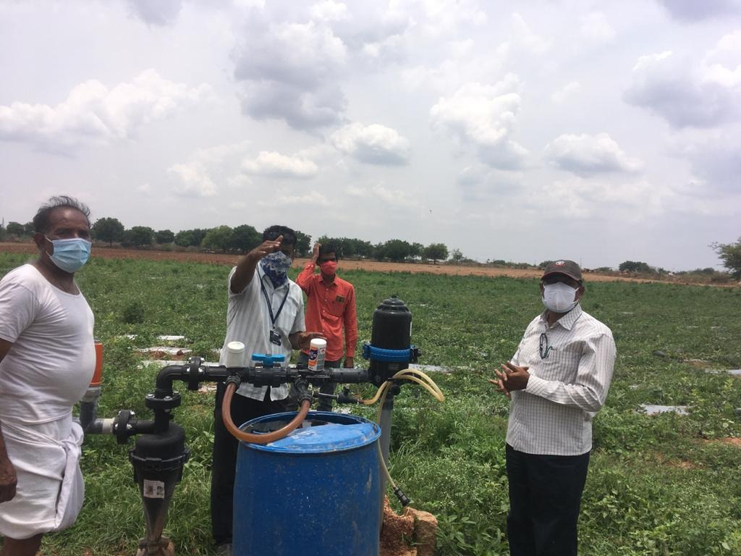
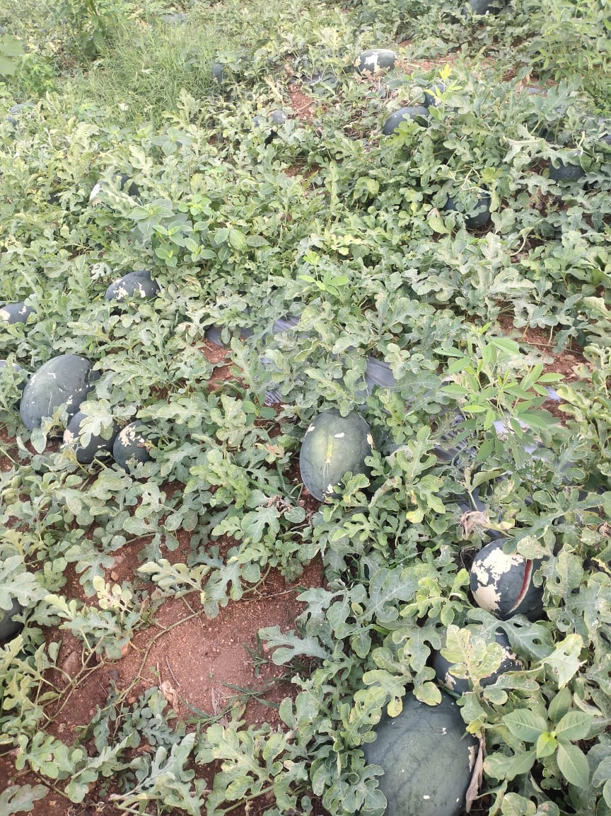
NLIS project
Measuring impact
The project team and JV partner Finolex have established drip irrigation system in one farmer’s farm to demonstrate benefits of the project.
Details of the farmer:
Name of the farmer: Shankarappa Sawkar
Crop grown before drip irrigation provision: Tore daal
Crop grown after provisioning of drip irrigation: Watermelon
Benefits of the implementation will be measured in the next quarter
(Please note:- As the project is not yet complete, water for drip irrigation was sourced from existing well. )

Slide 12
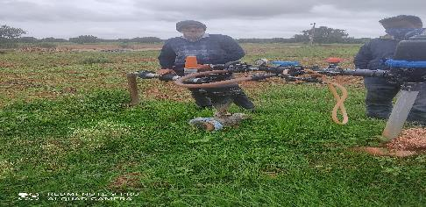
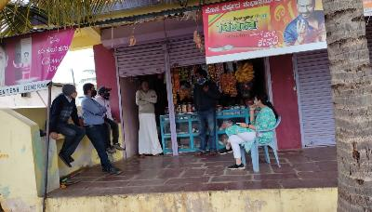
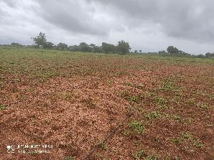
Impact of the project
1/3
Watermelon demonstration done by finolex in Khairwadgi village
Farmer Name: Sangappa Sahukar
Lateral spacing and discharge: 1.52 spacing and 2lph discharge
Crop variety: Water Melon KSP-1358
Time of cropping: Feb to March
Cost of farming excluding drip setup cost : Rs 79,250
Yield in tons: 49
Avg yield of watermelon in Karnataka: 20
Due to corona outbreak farmer was not able to get good rate for his produce. He received Rs 1,47,000
Net profit: Rs 67,750
Source of water: Borewell

